Slide 1


DEPARTMENT OF COMPUTER SCIENCE AND ENGINEERING
Project name : Smart Public Restroom
Team name : project_224780_Team_5
Team members : KAVIYA.S(113321104042)
KEERTHANA.M(113321104043)
KEERTHANA.M(113321104044)
KEERTHIKA.C(113321104045)

Slide 2
Project
Real-time Data Monitoring
A smart restroom management system allows facility managers to monitor real-time data on various restroom parameters, including occupancy, supply levels, and maintenance requirements. This real-time monitoring enables proactive decision-making and efficient resource allocation.
Automated Alerts and Notifications
Smart restroom management systems can be configured to send automated alerts and notifications to the facility management team. These alerts can be triggered by events such as low supply levels, high odor concentrations, or equipment malfunctions. By receiving timely alerts, facility managers can take immediate action and address issues before they escalate.
Data Analytics and Reporting
Data analytics and reporting capabilities are integral to a smart restroom management system. These features allow facility managers to gain valuable insights into restroom usage patterns, supply consumption trends, and maintenance requirements. By analysing this data, facility managers can make data-driven decisions to optimize operations and improve overall restroom management.
Remote Control and Configuration
A smart restroom management system enables remote control and configuration of restroom devices and systems. Facility managers can remotely adjust settings, monitor performance, and configure parameters without the need for physical access to each restroom. This remote control capability streamlines operations and reduces the need for on-site maintenance

Slide 3
Integration with Other Systems
Smart restroom management systems can be integrated with other building management systems, such as HVAC (Heating, Ventilation, and Air Conditioning) or access control systems. This integration enables a comprehensive view of the overall facility’s operations and allows for centralized control and management.
Smart Restroom Monitoring System: Ensuring Hygiene and Safety
A vital aspect of a smart restroom solution is the smart restroom monitoring system. This system utilizes advanced sensors and technologies to ensure optimal hygiene and safety in restrooms. Let’s explore the key features and benefits of a smart restroom monitoring system:
Occupancy Sensors
Occupancy sensors play a crucial role in a smart restroom monitoring system. These sensors accurately detect the number of users entering and exiting restrooms, providing real-time data on occupancy levels. By monitoring restroom traffic, facility managers can optimize cleaning schedules, ensure a smooth flow of users, and maintain social distancing protocols.
Odor Detection Sensors
Odor detection sensors are essential for maintaining a pleasant restroom environment. These sensors continuously monitor air quality and detect any abnormal odor concentrations. When an odor exceeds a predefined threshold, the system triggers an alert, allowing facility managers to take immediate action and ensure timely cleaning and ventilation.

Slide 4
Supply Level Monitoring Sensors
Supply level monitoring sensors are critical for preventing stockouts of essential restroom supplies. These sensors track the levels of items like toilet paper, soap, and paper towels. When supply levels reach a predefined threshold, the system sends an alert, enabling facility managers to restock supplies promptly and avoid inconvenience for users.
Real-time Surveillance Cameras
Real-time surveillance cameras provide an additional layer of security and monitoring in smart restrooms. These cameras can detect suspicious activities, monitor queue lengths, and assist in crowd management. By integrating surveillance cameras with the smart restroom monitoring system, facility managers can ensure a safe and secure environment for restroom users.
Analytics and Insights
A smart restroom monitoring system collects and analyses data from various sensors and devices. This data can be used to generate actionable insights and reports, allowing facility managers to identify usage patterns, detect anomalies, and optimize resource allocation. With these analytics and insights, facility managers can continuously improve restroom operations and enhance user experience.
Case Study: Smart Train Restroom
Smart train restrooms are a prime example of how smart restroom solutions can revolutionize public restroom experiences. These restrooms are equipped with advanced technology to ensure cleanliness, efficiency, and user satisfaction. Let’s explore the features and benefits of smart train restrooms:

Slide 5
CONCLUSION
The Future of Smart Restroom Technology:The future of smart restroom technology looks promising, with continuous advancements and innovations on the horizon. Here are some key trends that are shaping the future of smart restrooms
AI-powered Systems
Voice-activated Controls
Blockchain-based Solutions
Integration with Smart Buildings
Smart restroom technology is transforming the way we experience public and private restrooms. With features like occupancy sensors, odor detection, and supply level monitoring, smart restrooms enhance hygiene, efficiency, and user satisfaction. The implementation of smart restroom management systems and monitoring systems streamlines operations, optimizes resource allocation, and ensures a safe and pleasant restroom experience.
As technology continues to evolve, the future of smart restrooms looks promising, with AI-powered systems, voice-activated controls, and blockchain-based solutions on the horizon. By embracing these advancements, facilities can create smart restrooms that meet the ever-changing needs and expectations of users.
Investing in smart restroom solutions is not only a step towards operational excellence but also a testament to a commitment to hygiene, sustainability, and user satisfaction. With the continuous development of innovative technologies, smart restrooms are set to revolutionize the way we think about and experience public and private restrooms.

Slide 6
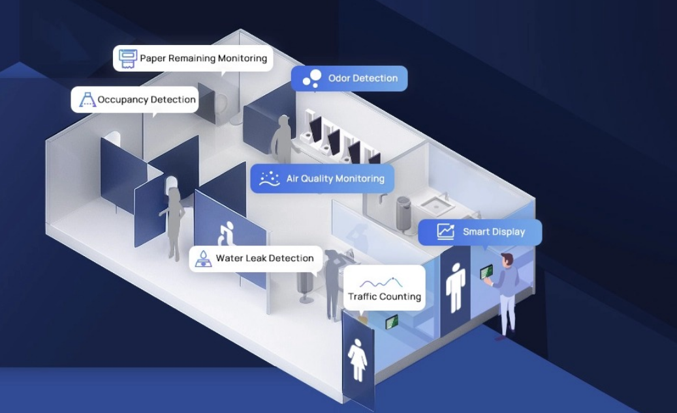

Slide 7
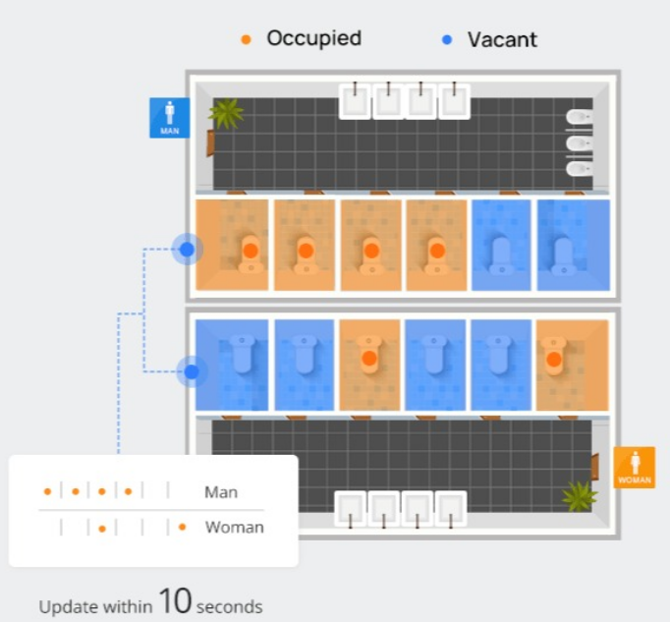
MODEL

Slide 8
THANK YOU

